Slide 1
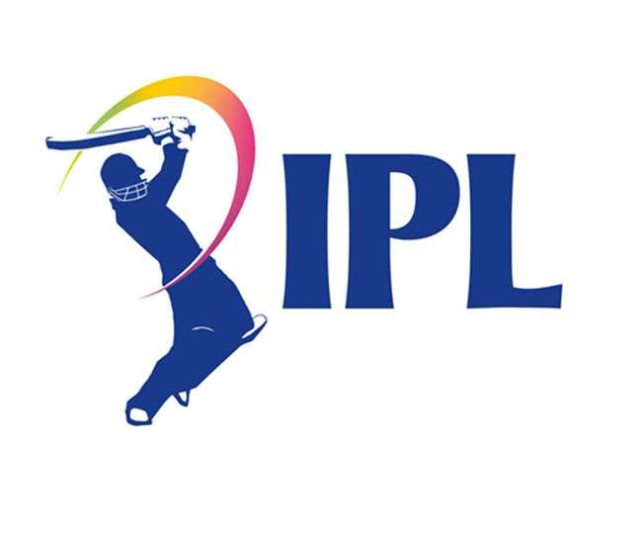
INDIAN PREMIER LEAGUE (2008-2023) Comprehensive Analysis and Visualization
Nagendra V Kini

Slide 2
Agenda
1
2
3
4
5
Introduction
Project Steps
Key Features
Insights
Conclusion

Slide 3
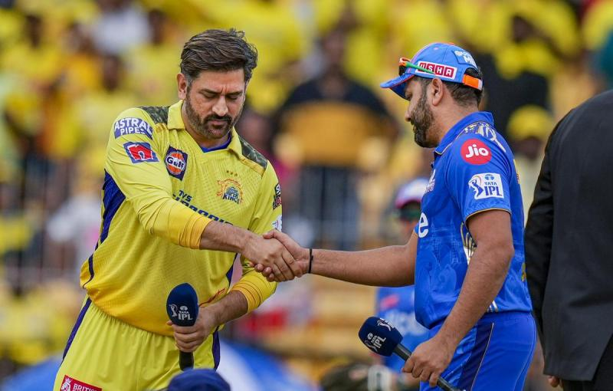
Introduction
Objective :-
To provide a comprehensive analysis of the IPL from 2008 to 2023.
To gain insights on title winners, orange cap winners, purple cap winners, and key trends.
Tools Used :- Tableau

Slide 4
Project Steps :-
Data Collection
Data Cleaning
Data Processing
Data Preparation
Visual Data Exploration
Interactive Dashboard Creation
Report Publishing and Sharing

Slide 5
Key Features
Title Winners
Analysis of teams winning the IPL each year.
Orange Cap Winners
Overview of the top run-scorers each season.
Purple Cap Winners
Insights into the top wicket-takers each season.
Player and Team Stats
Detailed statistics on player performances and team results.
Trends and Patterns
Identification of key trends and performance patterns across seasons.

Slide 6
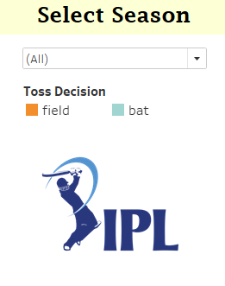
Filter
Filter :-
I conducted an analysis of the IPL, utilizing a filter to isolate data from each year between 2008 and 2023. This allowed me to examine yearly trends and insights within this timeframe.

Slide 7
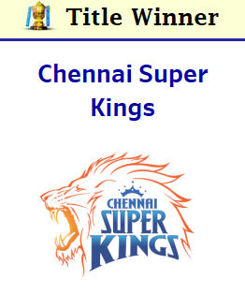
Insights
Title Winners Analysis :-
Overview of which teams won the IPL each year and any notable patterns or streaks.

Slide 8
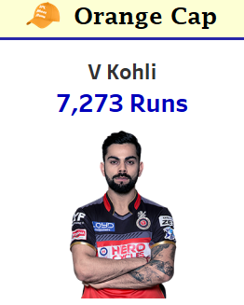
Insights
Orange Cap Winners :-
Highlighting the top run-scorers of each season and their performance metrics.

Slide 9
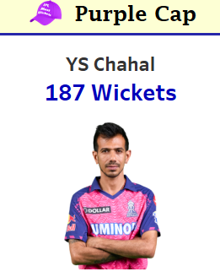
Insights
Purple Cap Winners :-
Analysis of the top wicket-takers of each season and their statistics.

Slide 10


Insights
Tournament 4’s & 6’s :-
During my analysis of the IPL, I discovered that the tournament has a total of 11,790 sixes and 27,675 fours.

Slide 11
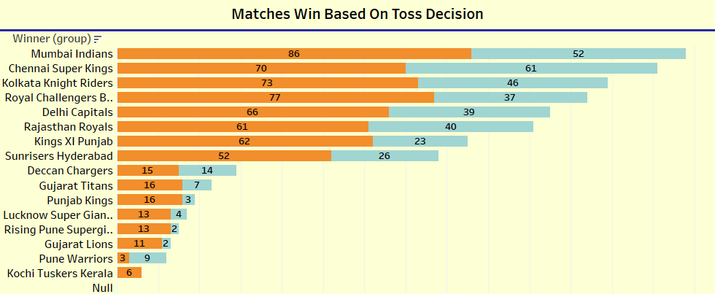
Insights
Matches Win Based On Toss Decision :-
I conducted an analysis of the IPL and found that the Mumbai Indians have won the most matches based on their toss decisions, outperforming other teams. Specifically, they chose to field first after winning the toss in 86 matches, winning 52 of those. Conversely, they opted to bat first in 61 matches. The second highest is Chennai Super Kings, who have won 70 matches by choosing to field after winning the toss and 61 matches by choosing to bat first.

Slide 12
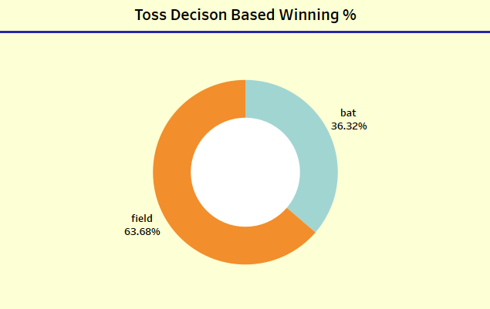
Insights
Toss Decision Based Winning :-
I have analyzed the IPL and discovered the winning percentages based on toss decisions. Teams that chose to field after winning the toss have a winning rate of 63.68%. In contrast, teams that opted to bat first after winning the toss have a winning rate of 36.32%.

Slide 13
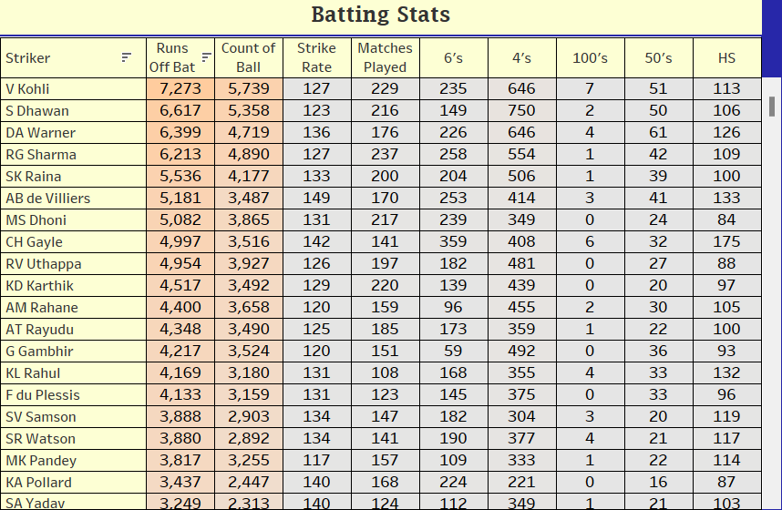
Insights
Batting Stats :-
I conducted an analysis of IPL batting statistics and found that Virat Kohli is the leading run-scorer with 7,273 runs at a strike rate of 127. His highest score in his IPL career is 113. Following him, Shikhar Dhawan is the second-highest run-getter with 6,617 runs, a strike rate of 123, and a highest score of 106.

Slide 14
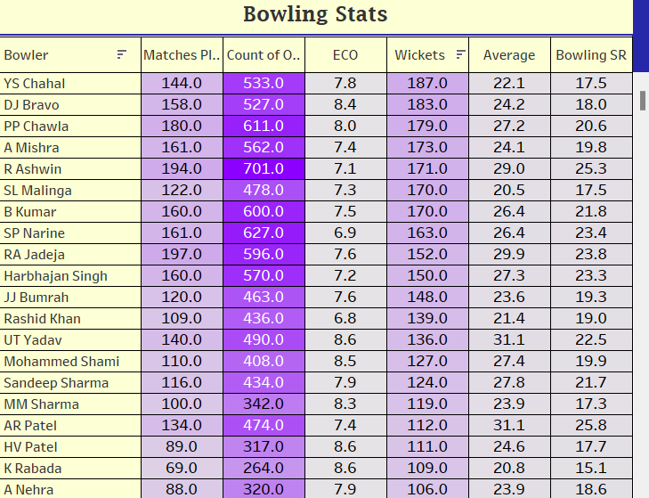
Insights
Bowling Stats :-
I conducted an analysis of IPL bowling statistics and found that Yuzvendra Chahal has taken the most wickets, with a total of 187 in 144 matches, and an economy rate of 7.8. Following him, Dwayne Bravo has taken 183 wickets in 158 matches, with an economy rate of 8.4.

Slide 15
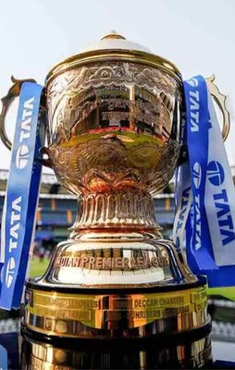
Conclusion
The dashboard provides a comprehensive analysis of IPL data, uncovering valuable insights and trends.-
Outcome :- Offers a unique perspective on the IPL, benefiting cricket enthusiasts and data analysts alike.
Call to Action :- Encourage the audience to explore the dashboard and share their feedback.

Slide 16
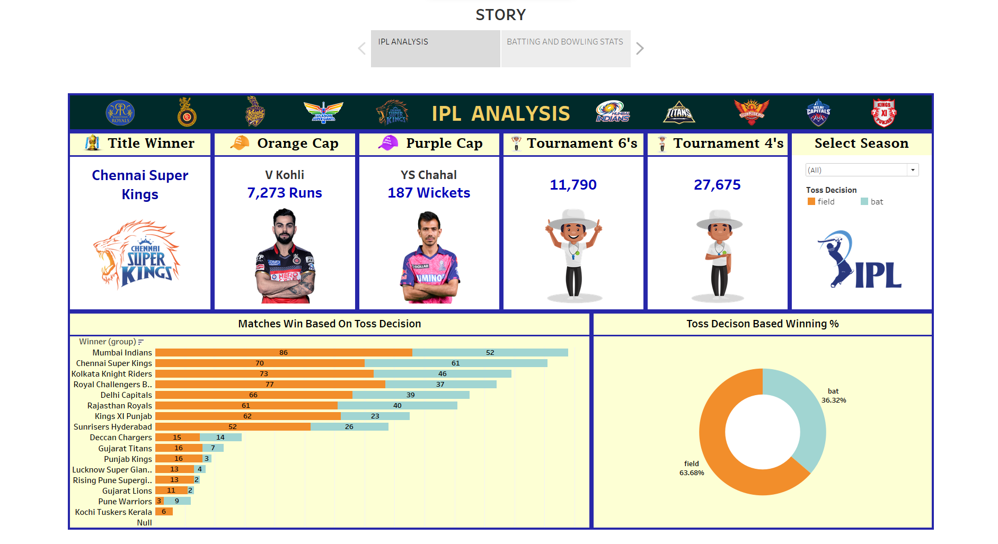
Dashboard

Slide 17
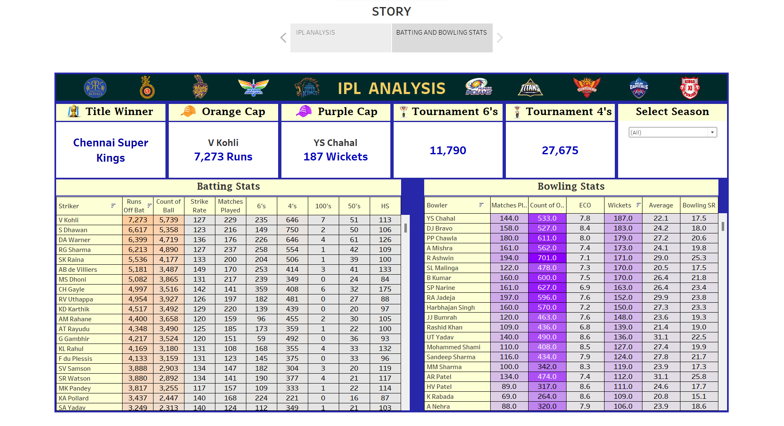
Dashboard

Slide 18
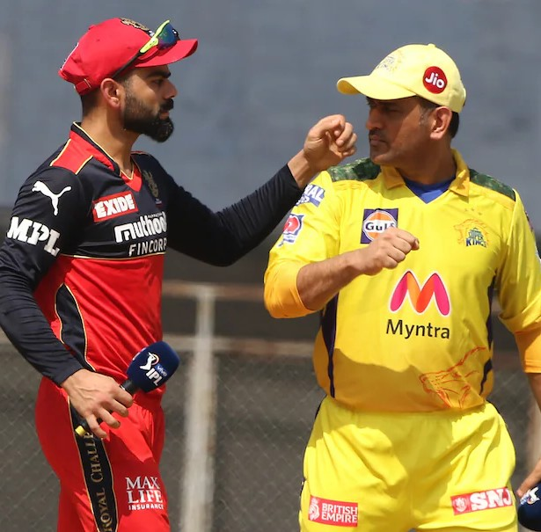
THANK YOU

